Slide 1
REALTIME FACE-SPEECH EMOTION RECOGNITION IN WORKER STRESS ANALYSIS

Slide 2
ABSTRACT
Work feedback is essential in Job Environment to keep a report between Management and Workers. There are three main factors that contribute towards a worker’s progress : behavioral, emotional, and cognitive.
The major component of human communication is facial expressions and Speech Signals. Facial and Speech expressions are used not only to express our emotions, but also to provide important communicative clues during social interaction, such as our level of interest, continuous feedback signaling understanding of the information conveyed.
The system automatically detects frontal faces in the video stream and codes each frame with respect to 7 dimensions: Neutral, anger, disgust, fear, joy, sadness, surprise. The facial features from the video source is extracted and mapped with the basic emotions.
This can be used in any kind of environment. Also It can Analyze the Speech Signals to Identify the Stress level of a Employee.

Slide 3

Stress contributes to sustained feeling of low-energy and depression.
Stress causes inefficiency during routine work which makes it a social cause.
Chronic stress can negatively affect people causing anxiety and bipolar disorders.
Mental stress can also take a toll on our physical health. As per the recent survey 526,000 workers suffering from work-related stress, depression or anxiety (new or long-standing) in 2020.
Mental health care has become a demand.

Slide 4
LITERATURE REVIEW
Author & Year | Title | Contribution | Limitations
1.Saad ALBAWI , Tareq Abed MOHAMMED 2017 | Stress detection in working people | Linked facial expression with analyzing stress | They had no clear idea how to detect the stress
2. Vlad-Adrian Stefanescu , Ion Emilian Radoi 2019 | Mental Stress Recognization based on non-invasive and non contact measurement from stereo-thermal and visible sensors | Explained about stress recognization using bio- signals ,thermal image and general image | More pre-requisites required like respiration response, galvanic skin response.
3. Taejae Jeon, Hanbyeol Bae 2020 | Support vector /binary tree architecture for facial stress recognization based on gabor and HOG feature | Proposed an algorithm that uses a cascade method of the features if extracted by random –fern and the regression tree classifier | Regresses analization of image.

Slide 5
A. Stress Recognition using Bio signals | Bio signals were used in early stress recognition research because they show the body's most sensitive changes, while allowing it to identify changes in the body that are not revealed by face and behavior. In these studies, they extracted and used features that can express stress in bio signals such as Electrocardiogram, Electrodermal Activity, Respiration, Galvanic Skin Response, and Heart Rate Variability. And many of them used classical classifiers such as Support Vector Machine, Linear Discriminant Analysis, Ad boost, and K-Nearest Neighbor.
B. Stress Recognition using Thermal Image | When a person is stressed, the blood flow of the face increases and the temperature of the face increases, so a lot of research has been conducted to detect the change by using the thermal image to detect the change. In these studies, many methods were used to recognize stress by extracting features directly from thermal images or by extracting features such as respiratory rate, number of blinks, skin temperature, and blood flow from thermal images.

Slide 6
C. Stress Recognition using General Image
When a person is under stress, eye, mouth, and head movements are different from normal situations, and research on stress recognition using general images is also being conducted. In these studies, many methods were used to recognize stress such as extracting hand-crafted features from the eyes, nose, and mouth areas or using eye size, mouth movements, and head movements as features.

Slide 7
PROBLEM IDENTIFICATION
In the beginning, facial expression analysis was essentially a research topic for psychologists. However, recent progresses in image processing and pattern recognition have motivated significantly research works on automatic facial expression recognition. In the past, a lot of effort was dedicated to recognize facial expression in still images.
The automatic facial expression recognition system includes:
Face Detector.
Facial feature extractor for mouth, left and right eye. Facial Characteristic Point - FCP extractor.
Facial expression recognizer

Slide 8
EXISTING SYSTEM
In Existing system the major depression is one of the most frequent types of problem. There are almost nearly 450 million people suffering from depression.
Some approaches use the temperature of the finger, human gestures and eye blink as a modality to detect stress.
Recent techniques employ thermal imaging, physiological signals for stress detection

Slide 9

DISADVANTAGES
Depression and Suicide is a multifaceted problem.
Identification of Risk factor is difficult.
Less functionality

Slide 10
PROPOSED SYSTEM
➢The main objective of this project is to design an efficient and accurate algorithm that would detect behavior analysis of the worker, behavior detection of the worker.
➢It saves the man power and time of the faculty.
➢For the face detection to work efficiently, we need to provide an input image which should not be blur or printed. We have used algorithm that is used for face detection and facial feature extraction.
➢Also this system can recognize the Speech signals of the person with Feature Extraction Can be Done via MFCC feature Extraction from that it can analyze the stress level of the person using Speech Signals also..

Slide 11
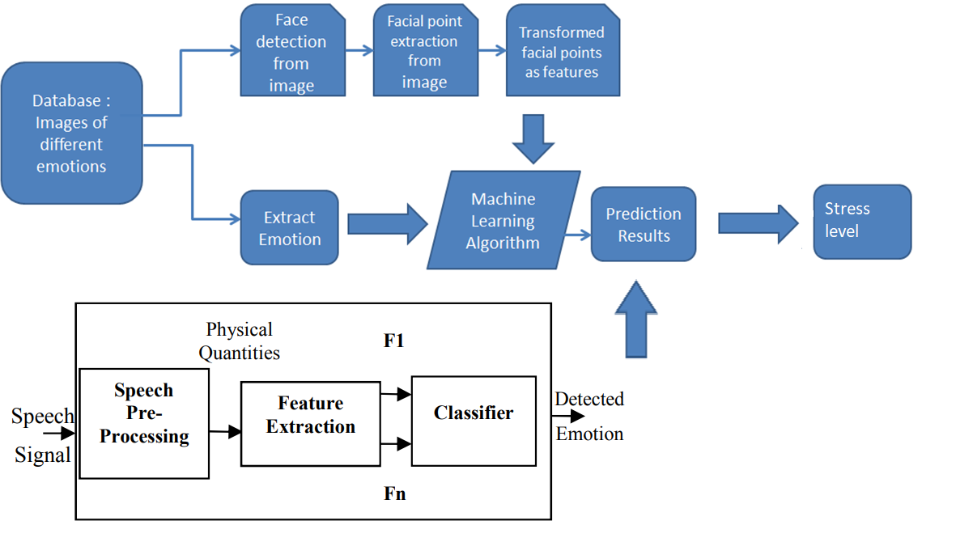
ARCHITECTURE

Slide 12
COMPONENTS REQUIRED
HARDWARE REQUIREMENTS
System
Hard Disk
Ram
: intel i3/i5 2.4 GHz.
: 500 GB
: 4/8 GB
SOFTWARE REQUIREMENTS
Operating system
Software Tool
Coding Language
Toolbox
:
Windows.
Open CV Python Python
Image processing toolbox. Librosa Audio Library
:
:
:

Slide 13

OpenCV
It is a library of programming1functions mainly aimed at real-time1computer vision. It is developed by Intel research center and subsequently supported by1Willow Garage and now maintained by itseez. It is written in C++ and its primary interface is also in C++. Its binding is in Python, Java, and Mat lab. OpenCV runs on a variety of platform i.e.
Windows, Linux, and MacOS, OpenBSD in desktop and Android, IOS and Blackberry in mobile. It is used in diverse purpose for facial recognition, gesture recognition, object identification, mobile robotics, segmentation etc. It is a combination of OpenCV C++ API and Python language. In our project we are using OpenCV version 2 OpenCV is used to gesture control to open a camera and capture the image. It is also used in the image to text and voice conversion technique.

Slide 14

eSpeak
It is a compact open source software speech synthesizer for English and 11other languages for Linux and Windows platform. It is used to convert text to voice. It supports many languages in a small size. The programming for eSpeak software is done using rule files with feedback. It supports SSML. It can be modified by voice variant. These are text files which can change1characteristics such as1pitch range, add effects1such as echo, whisper and croaky voice, or make systematic adjustments to formant frequencies to change the sound of the voice. The default speaking speed of 180 words per minute is too fast to be intelligible. In our project eSpeak is used to convert the text to voice signal.

Slide 15
METHODOLOGY
Step 1: Convolution
A convolution is a joined integration of two methods that demonstrates to you how one method changes the other.
Step 2: Apply the ReLu (Rectified Linear Unit)
In this step, the corrective function is used to increase nonlinearity on DNN. The data set is made up of different objects which are not linear to one another. Under this function, the grouping of information can be seen as a linear problem, although it is a non-straight problem.
Step 3: Pooling
Spatial invariance is a term that does not influence the neural network's ability to detect its particular feats when finding an item in the data collection. Pooling helps DNN to detect swimming pools, such as max and min pools, for example.

Slide 16
Step 4: Flattening
The next move is to flatten the pooled diagram of functions . Flattening means that the entire matrix of the pulled-up map is transformed into the neural network in a single column.
Step 5: Full connection
The flattened feature map should be moved through the neural network after flattening. This transfer is made via the plate, the completely attached plate, and the output sheet. The completely connected layer is similar to the hidden DNN layer but is in this case connected.
Groups are supported by the output sheet. Knowledge is sent over the network and it calculates a prediction error. The failure is spread back through the network to improve the prediction. Usually, the last numbers the neural network produces are not even one. Yet these estimates must be reduced to zero to one, reflecting each class's probability. This is the role SoftMax plays.

Slide 17
EXISTING AND PROPOSED MODEL
Existing Model | Proposed Model
1. The existing methods of stress analysis include paper method (self report), body fluid testing and physiological parameter evaluation. | In the proposed algorithm, face image and facial landmark detection with Speech Emotion Detetcion is performed first for stress recognition.
2. Paper method is performed by providing a multiple choice questionnaire and asking the subjects to answer it, where each choice will have a particular score. | We used a Deep Neural Network (DNN) algorithm
3. Once the subject is done with the questionnaire, the scores of each choice will be summed up to obtain a final score which indicates the stress level of that person. | In the proposed network, the face images and expression detected earlier are inputted to output stress recognition results.
4. Body fluid testing such as saliva testing or blood testing is done for the detection of stress hormone, Cortisol. | The results of stress recognition are composed of three classes: no stress, weak stress, and strong stress.
Page no. 24

Slide 18
RESULT
The main purpose of our project is to detect the stress level of a person using facial expressions with Speech Signals.
The requirements of the project has been met and successfully executed using the technologies like Anaconda Navigator.
The result was in the form of six emotions, where it tells the percentage level of each emotions.

Slide 19
ADVANTAGES
Early Detection of Person Behavior.
Easy to Implement.
Cost Effective.
Easy to identify the conditions of the person.
Detect the stress and non stress conditions.

Slide 20
APPLICATIONS
It could be at schools, universities etc. by counsellor.
People at MNCs are working continuously in front of computers, they don’t have time to take care of their health , so it will give them suggestion to take a break.
It could be used by psychiatrist.

Slide 21
CONCLUSION
Human stress has risen for several days, leading to significant health problems. Throughout the management of stress, higher stress is therefore necessary.
DNN for training content classification. DNN is used for classification. Since it is very difficult to identify big data files with a conventional approach, social media data is used to describe the training file.
Class 0, class1, and class2 of the tests of the Emotion uses. Class 0 suggests a positive stress level, Class 1 displays negative stress levels and Class 2 corresponds to a neutral stress level.

Slide 22
FUTURE SCOPE
This software only works when the person is sitting infront of camera, so in future we can try to give the remote access.
Camera should ask for permission of on and off before running.
We can train our project to give suggestions too , when the person is detected as stressed.

Slide 23
REFERENCES
Zhang, K., Zhang, Z., Li, Z., & Qiao, Y. (2016). Joint face detection and alignment using multitask cascaded convolutional networks. IEEE Signal Processing Letters, 23(10), 1499-1503.
Saad ALBAWI , Tareq Abed MOHAMMED (2017). Stress detection in working people. Procedia computer science, 115, 359-366.
Vlad-Adrian Stefanescu ,Ion Emilian Radoi (2019). Mental stress recognition based on non-invasive and non-contact measurement from stereo thermal and visible sensors. International Journal of Affective Engineering, 14(1), 9-17.
Taejae Jeon, Hanbyeol Bae, (2020). Support Vector Slant Binary Tree Architecture for Facial Stress Recognition Based on Gabor and HOG Feature. In 2018 International Workshop on Big Data and Information Security (IWBIS) (pp. 63-68). IEEE.

Slide 24



